Slide 1
WEL-COME

Slide 2
Dr. V.P. Shetkari Shikshan Mandal’s Padmbhooshan Vasantraodada Patil Institute of Technology Budhgaon (Sangli) Computer Science and Engineering
“Identification Of Grape Leaf Disease Using Deep Learning”
Student Name | Roll No
Sumit Shahaji Bhore | 4139
Vasundhara Bhagwan Patil | 4129
Sujal Subhash Koli | 4149
Rohit Sanjay Waghmode | 4152

Slide 3
Introduction:-
India is agricultural country and our sangli region is basically surrounded by various farming. Also we are from
farmers family. Tasgaon is highest in grape cultivation in Sangli District. In total area approximately 21% grapes are cultivated in Tasgaon. In the farmers view it is a cash crop which give economical benefits as compare to other crops.
Crops are facing many diseases nowadays. These diseases lead to major damage and economic loss and hence early detection of disease is necessary to prevent the damage acquired by the crops.

Slide 4
Motivation It is very difficult for farmers to identified various disease in plants. > The estimated annual crop losses due to plant disease at world wide is $60 Billions. The traditional tools and techniques are not very useful since it takes up lots of time and manual work. However with the help of disease detection system these difficulties will no longer prevent

Slide 5
Methodology
This project classifies diseases in grape plant using CNN (Convolutional Neural Network) Machine Learning classification algorithms. Grape plants are susceptible to various diseases.
The diseases that are classified in this project are:
Black rot
Black Measles (esca)
3.Leaf blight
4.Healthy

Slide 6
Flowchart
Input Image
Processing
Segmentation
Feature Extraction
Result
Solution
classification

Slide 7
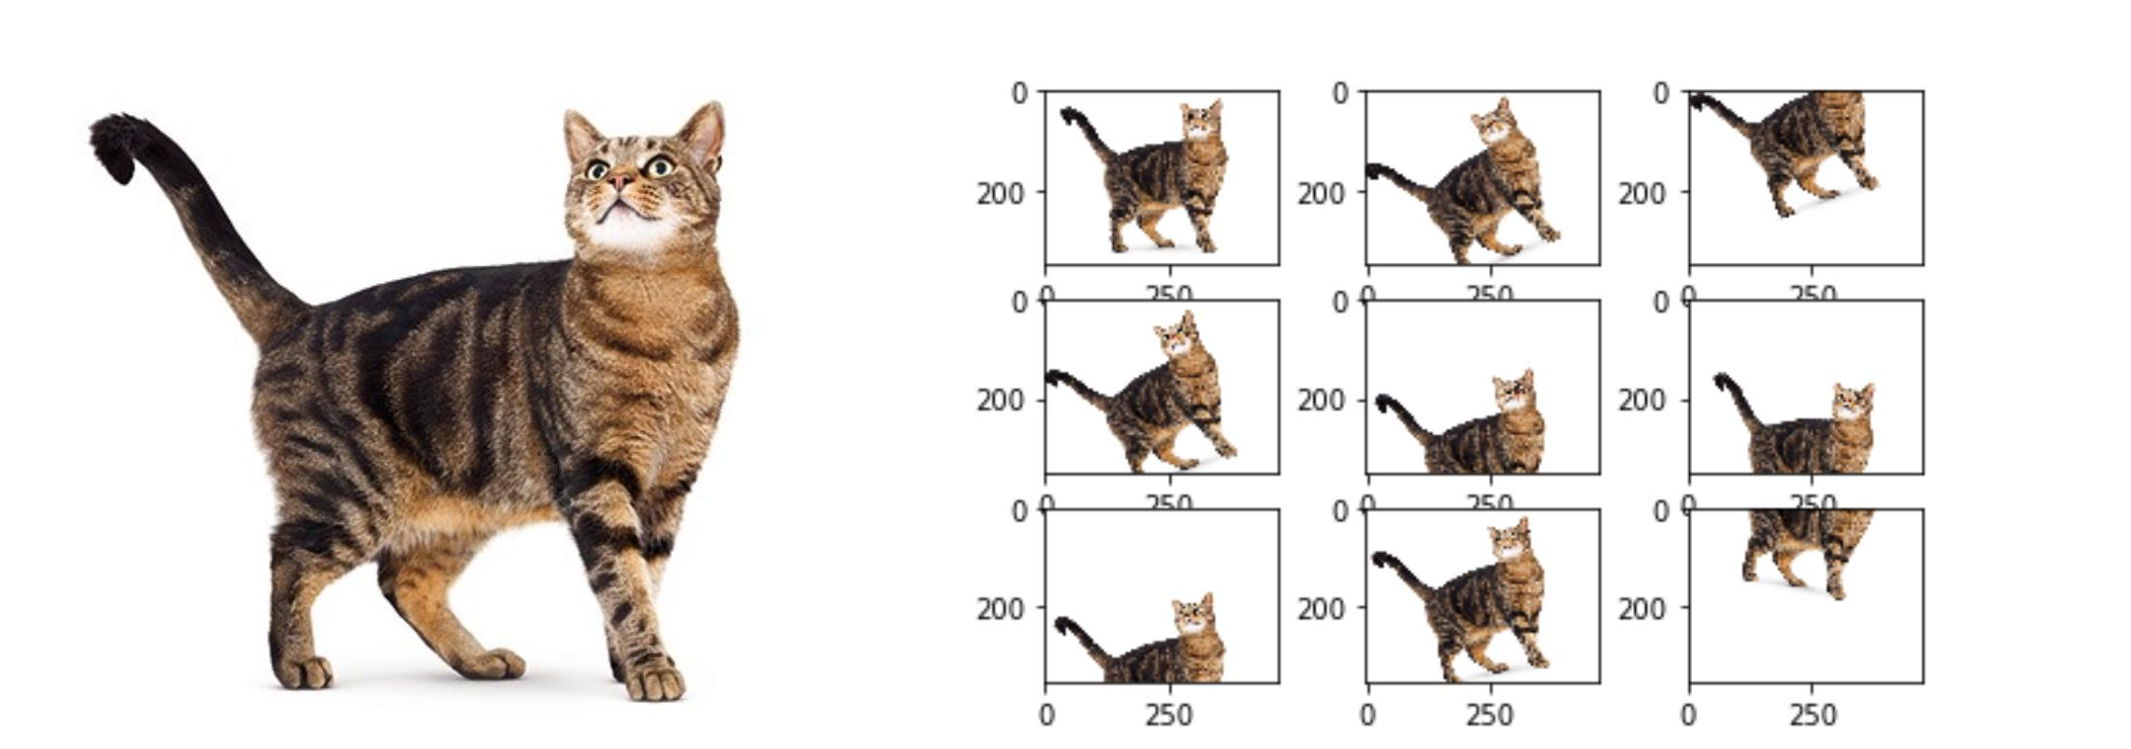
Data Augmentation

Slide 8
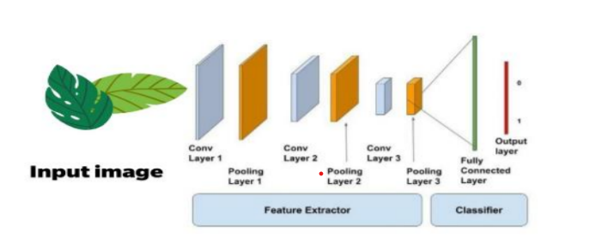
Feature Extraction

Slide 9
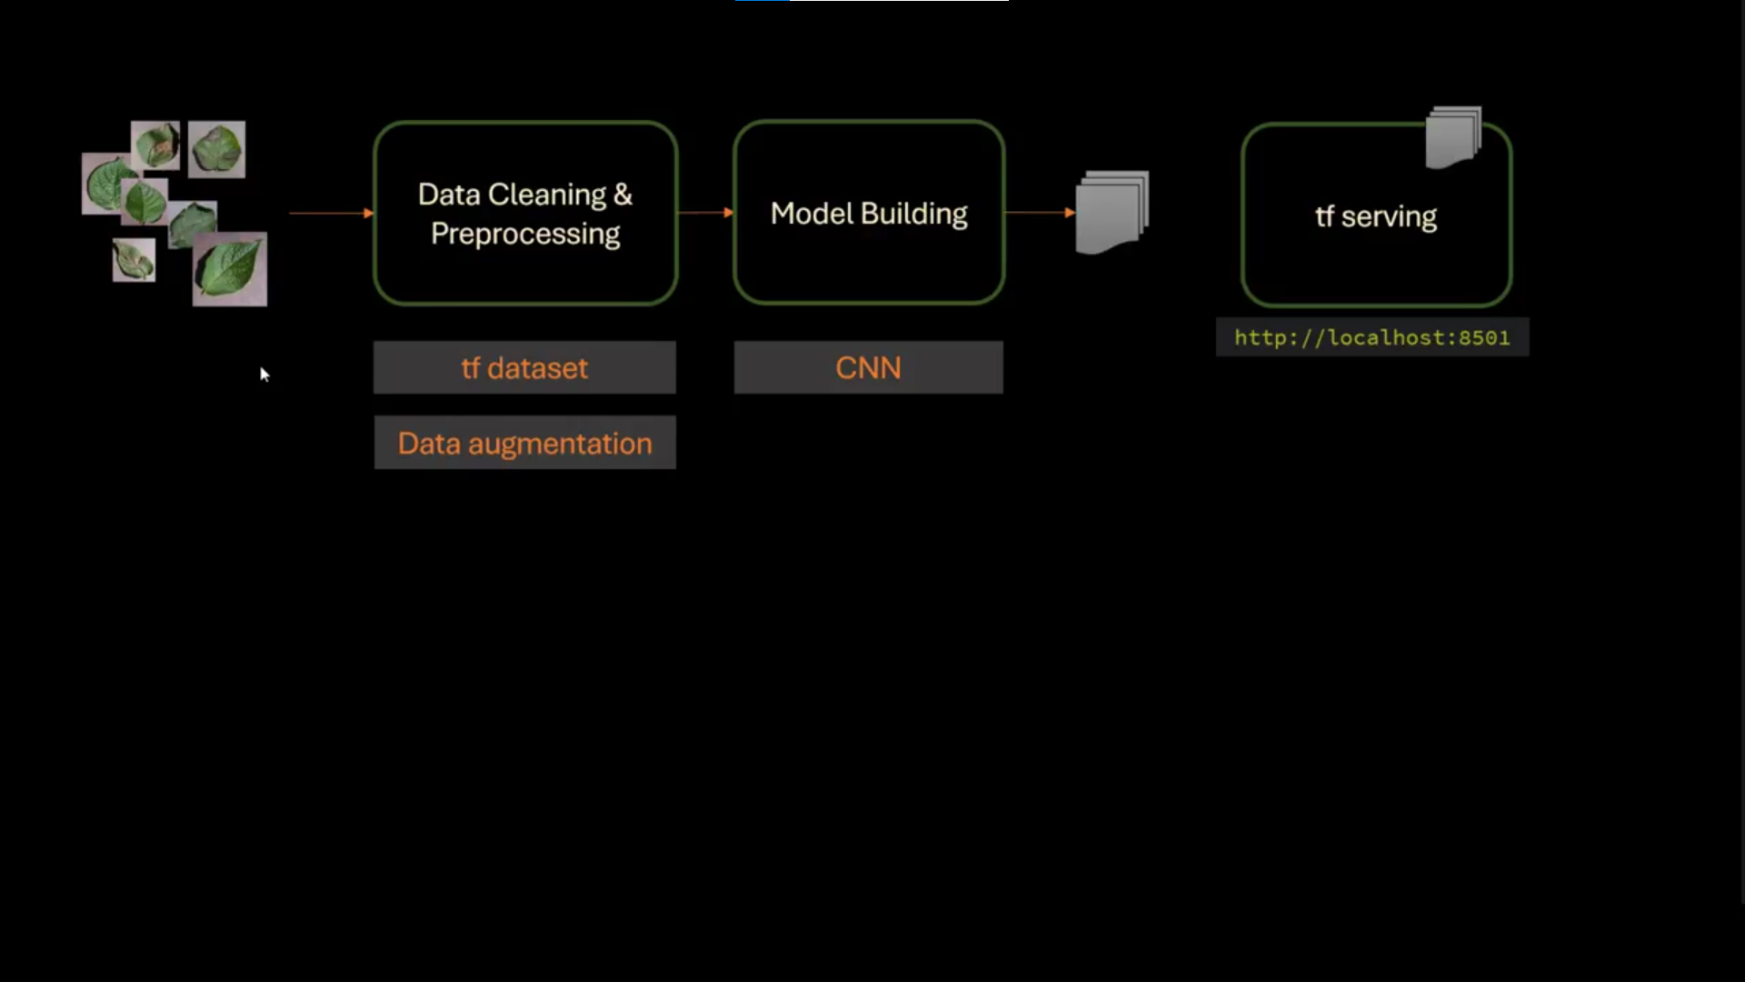
Implementation

Slide 10
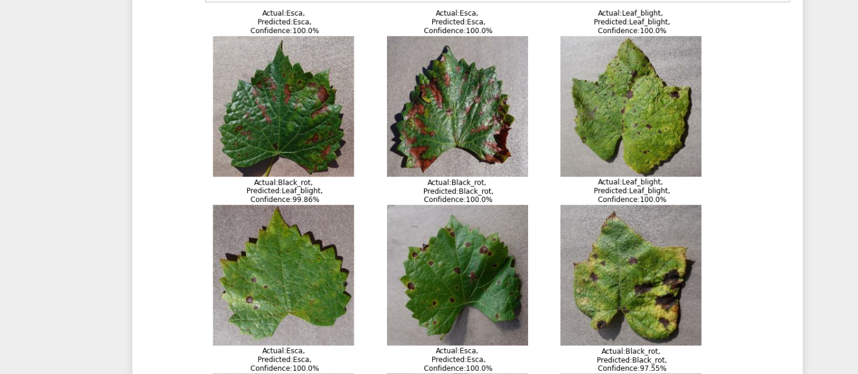
Testing Phase

Slide 11
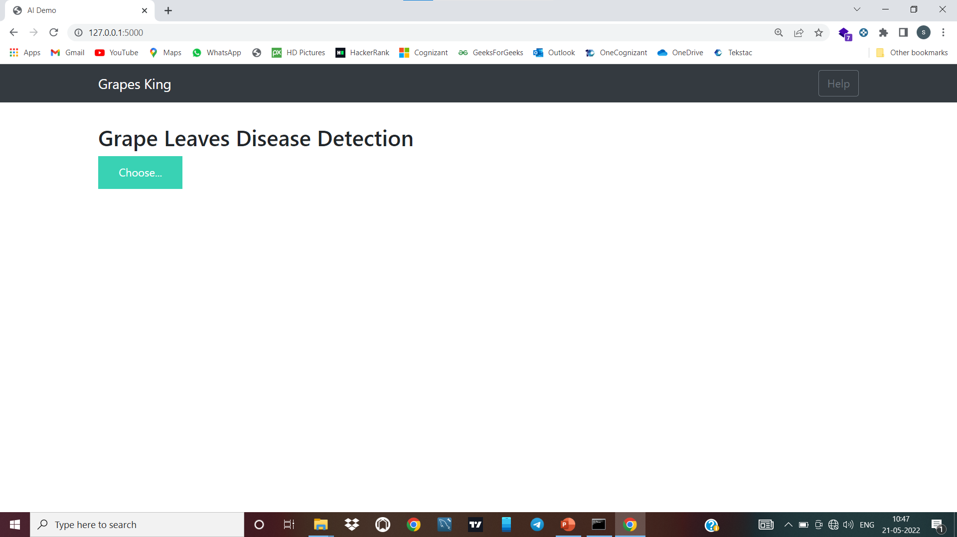
Model Deployment Using Flask
Website Design

Slide 12
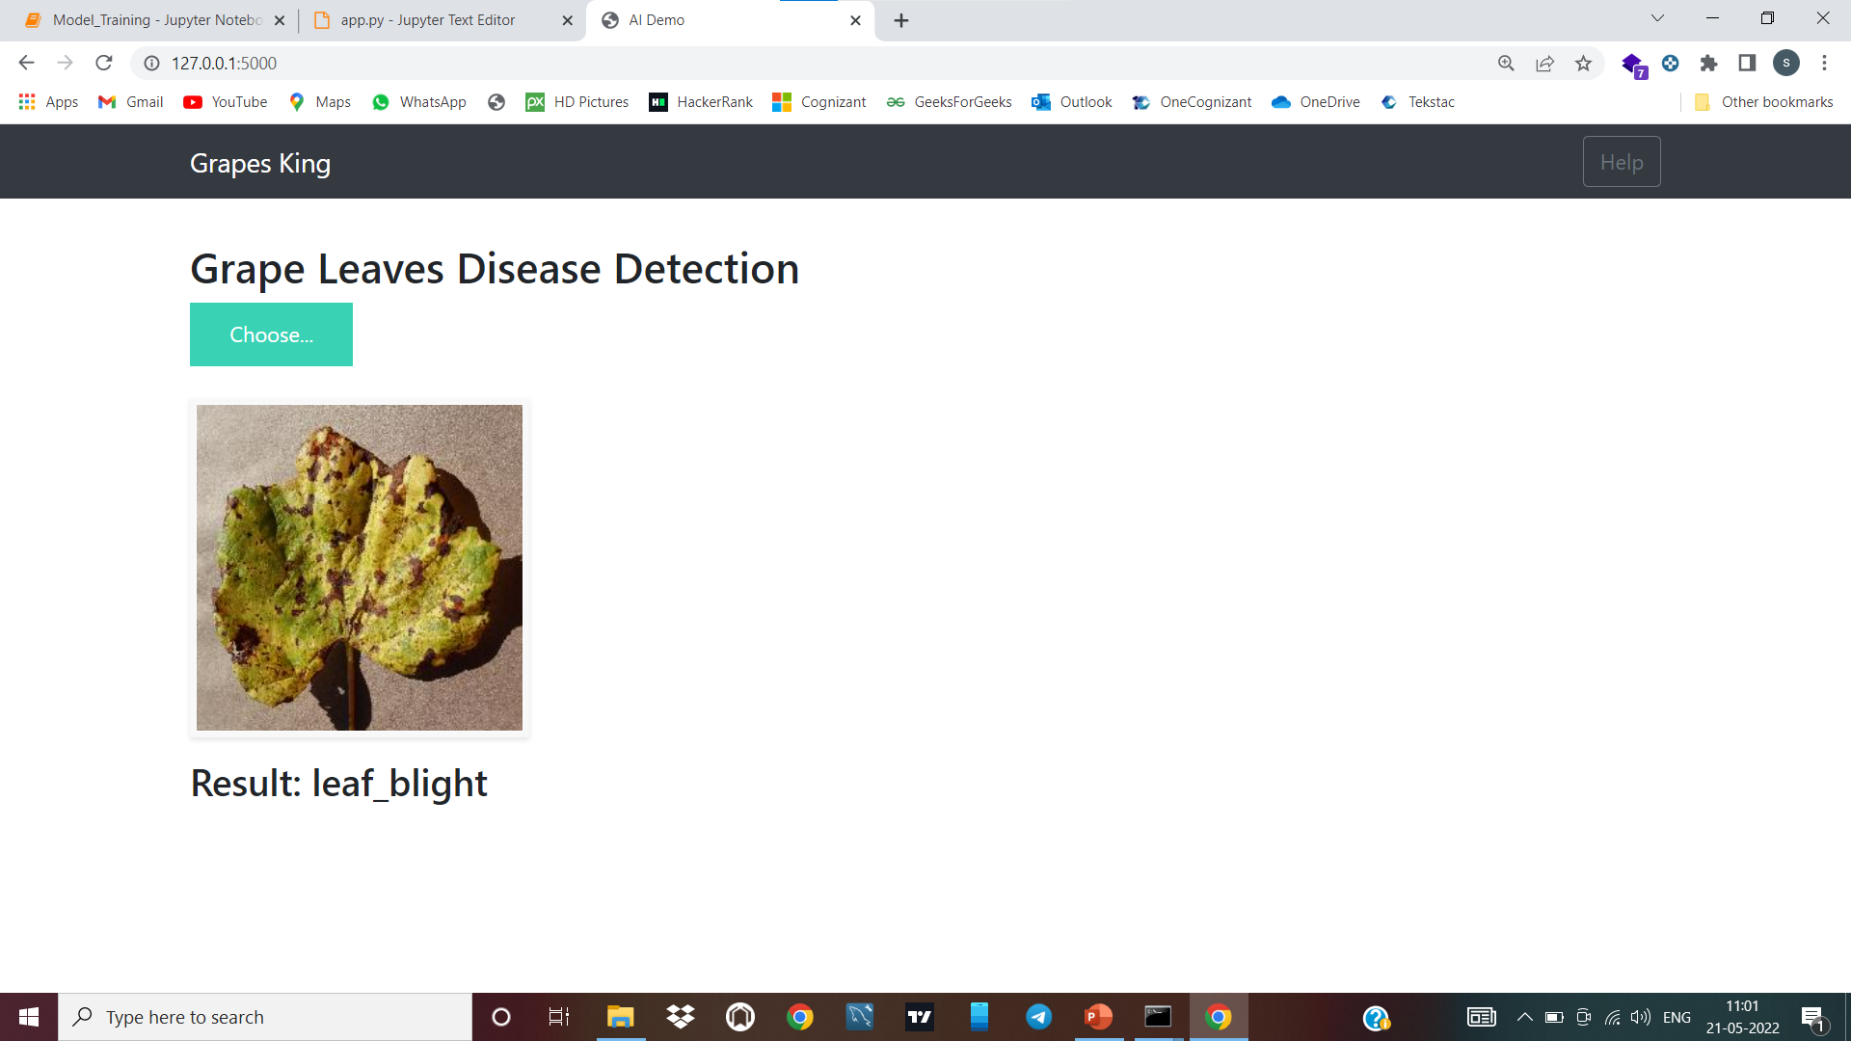
Model Testing

Slide 13
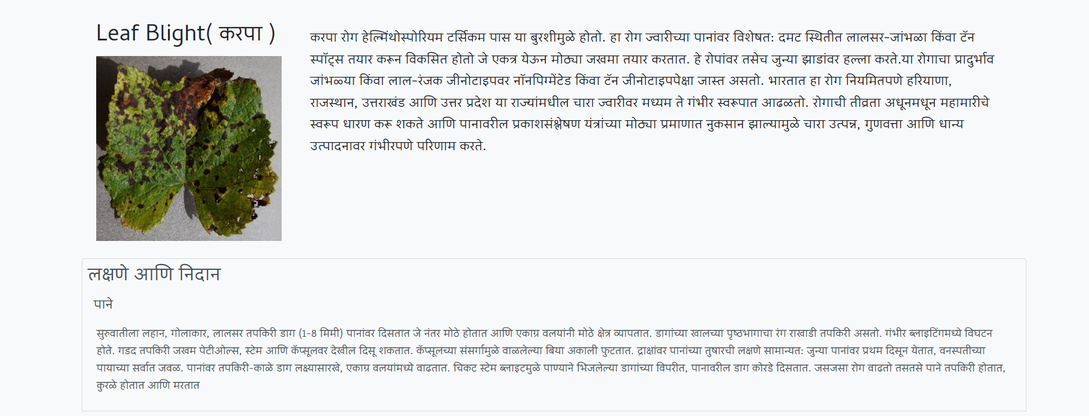

Slide 14
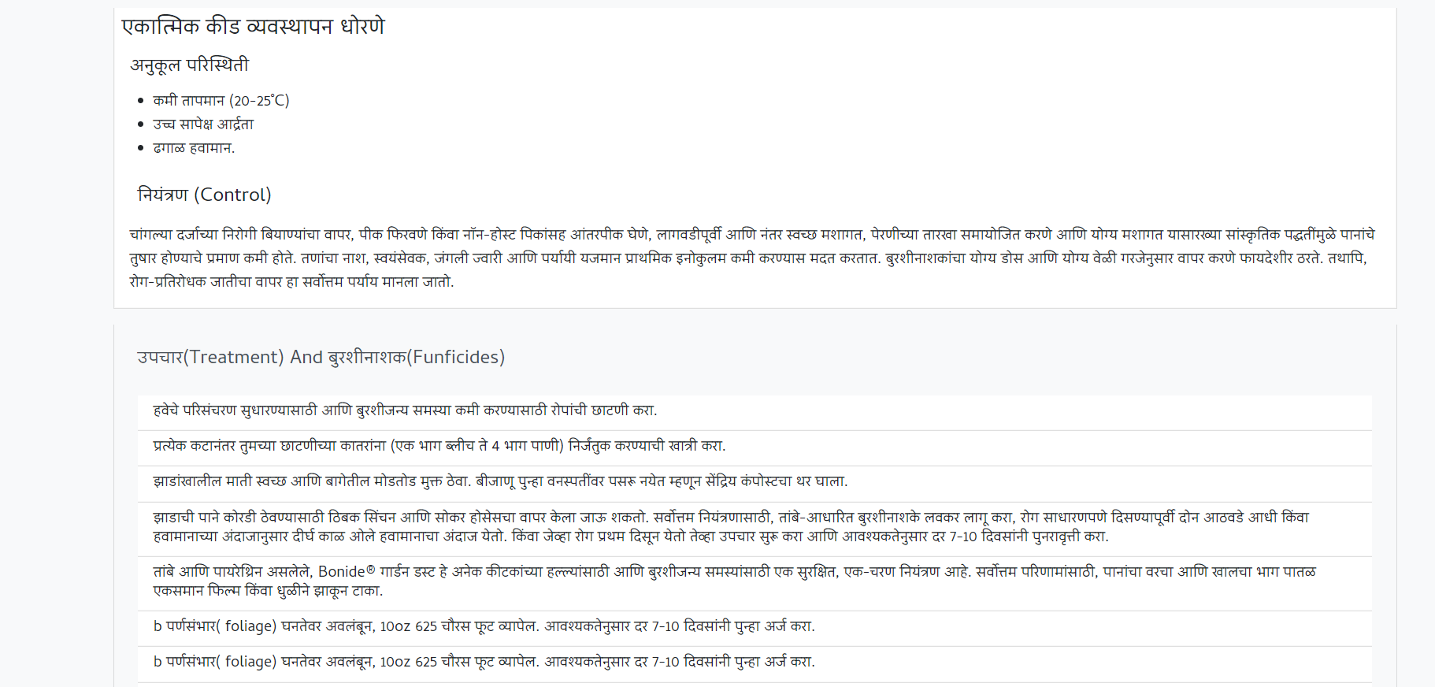

Slide 15
LITERATURE SURVEY
1. International Conference on Communication and Information Processing (ICCIP)
2. International Research Journal of Engineering and Technology (IRJET)

Slide 16
Thank You

